Slide 2

Continuous Integration (CI) Practices
on ZephyrTM Upstream
Hake Huang
Senior Software Engineer
NXP Semiconductor Inc.

Slide 3
Abstract
Abstract
We will present a CI system based on several popular open source projects
Zephyr^{(TM)} Docker file
Jenkins cloudy services Docker
Task scheduler system for multi-board testing
Virtualization validation system
With this system setting, we build up a CI system with minimum supporting resources and high reliable quality tracking and validation for upstream patches in ZephyrTM BSP support.

Slide 4
Continues integration test in Zephyr
Zephyr project uses ShippableTM as CI framework. Link
It is not public available, thus customization for general users are not possible.
e.g. hard to dynamically change the test sets, test stuff is mixed in the same git repo.
Connection with other devops system is difficult.
No peripheral testing conducted on real board. This problem has deep impacts on real applications quality lifecycle.

Slide 5

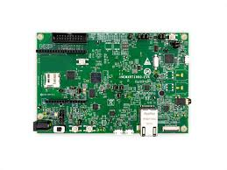




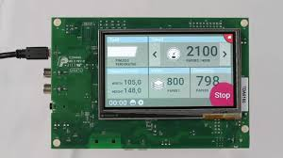
User cases for upstream
Zephyr repo
Upstream tasks
Function test
Continues Integration Test
Zephyr Community

Slide 6
Requirements on a CI system for upstream
Test on request
Common & user friendly
Stateless process
Reliable flash mechanism
Result process
Result storage
Configurable testing scope for boards.
Open Source framework
Task scheduler
Board client which can accept test image and download to board
Console logger and judging scripts
Docker ftp image for storage logs

Slide 7
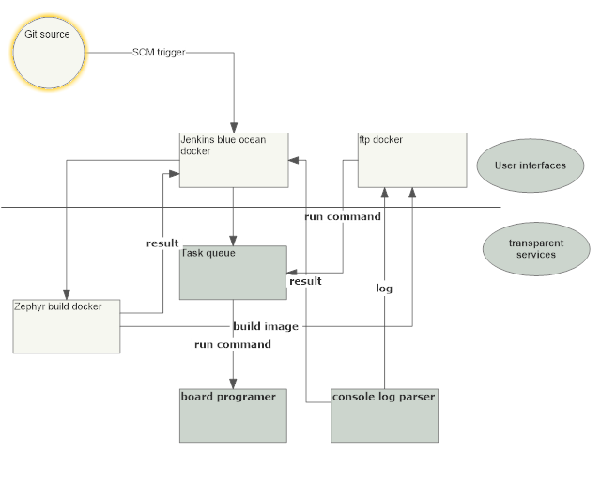
CI system for upstream

Slide 8
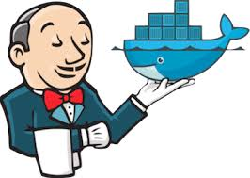



Dockers that are used
https://hub.docker.com/r/jenkinsci/blueocean/
CI system with database
https://hub.docker.com/r/stilliard/pure-ftpd
log / binary storage
https://github.com/zephyrproject-rtos/ci-dockerfiles.git
Zephyr build docker
https://hub.docker.com/_/celery
Task queue

Slide 9
Deployment
Ethernet
github/ bitbucket
Cloudy ECS
PYOCD
UART
SCM system
All Dockers deployed here
Flash machine
Target board

Slide 10
Connect dockers
Docker shared volumes https://docs.docker.com/storage/volumes/
Intra docker call
docker exec <docker name> <command>
mount /var/run/docker.sock for each docker container
Note:
use docker exec is more preferable if your dockers are running in one server.

Slide 11
Glue scripts
Jenkins blue ocean configured by pipe line.
https://jenkins.io/doc/book/pipeline/jenkinsfile/
We using a glue script to create dynamic pipeline files
https://github.com/hakehuang/zephyr_app_scm
Pipe file is checked in each time in a integration test git repo

Slide 12
Flash system
A board program scripts are thus designed to support reliable board download
https://github.com/Hoohaha/pymcutk
Latest and compromised board program method supporting

Slide 13
Working process
Automatic
Original developing branch
integration PR
SCM Jenkins trigger
Blue OceanTM UI
Add pipe line file
Manual efforts
Blue OceanTM call
Jenkins database
Docker call in zephyr
Task queue
Image in FTP docker
Run cases
result in FTP docker

Slide 14
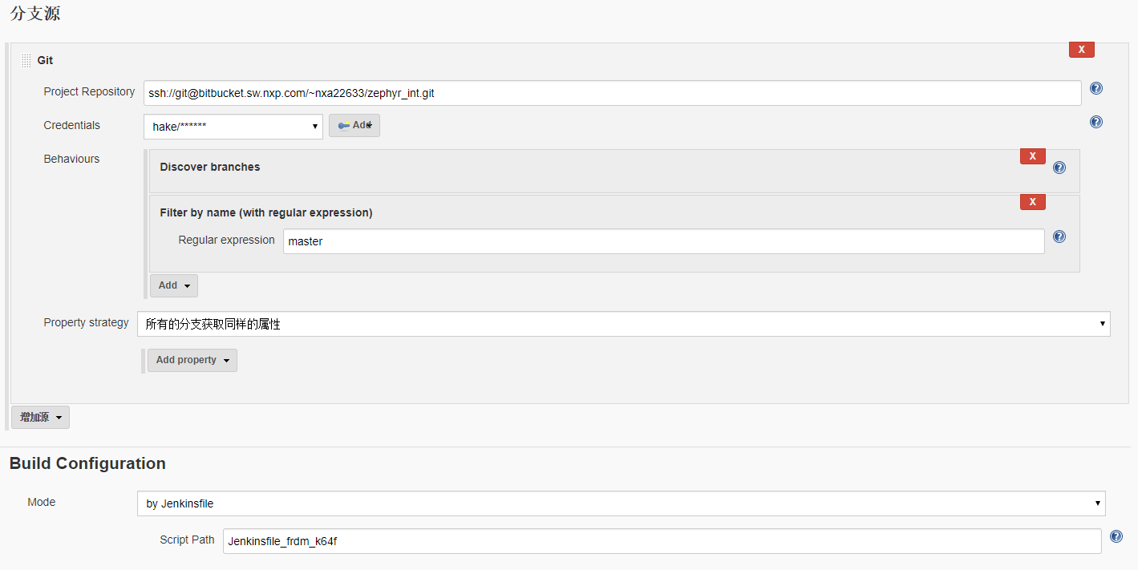
Examples
- configure

Slide 15
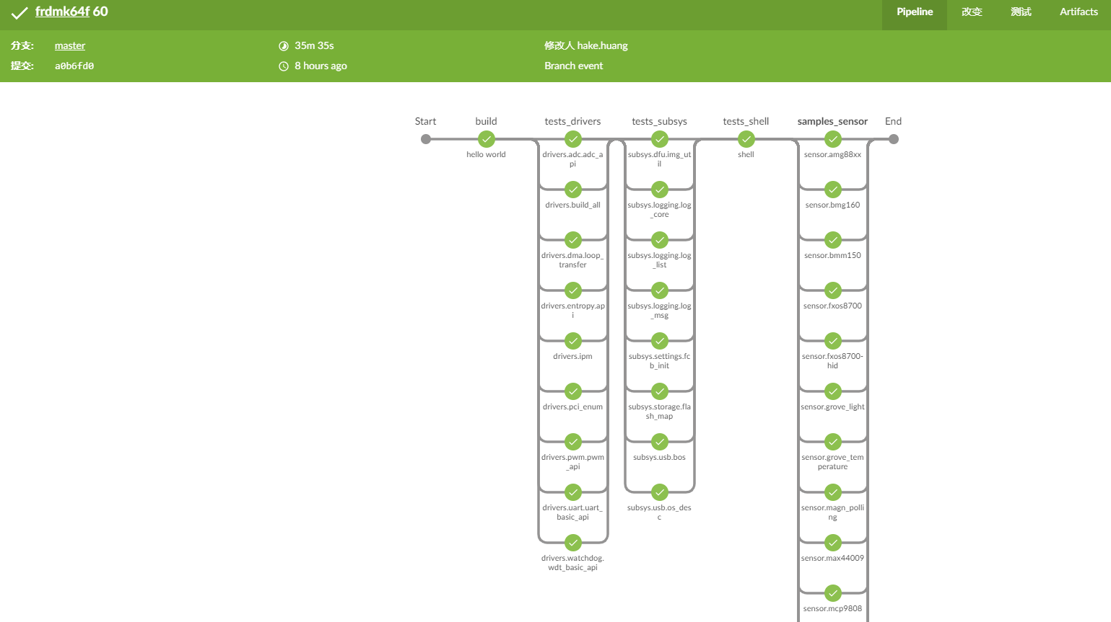
Examples
- Pipeline view

Slide 16
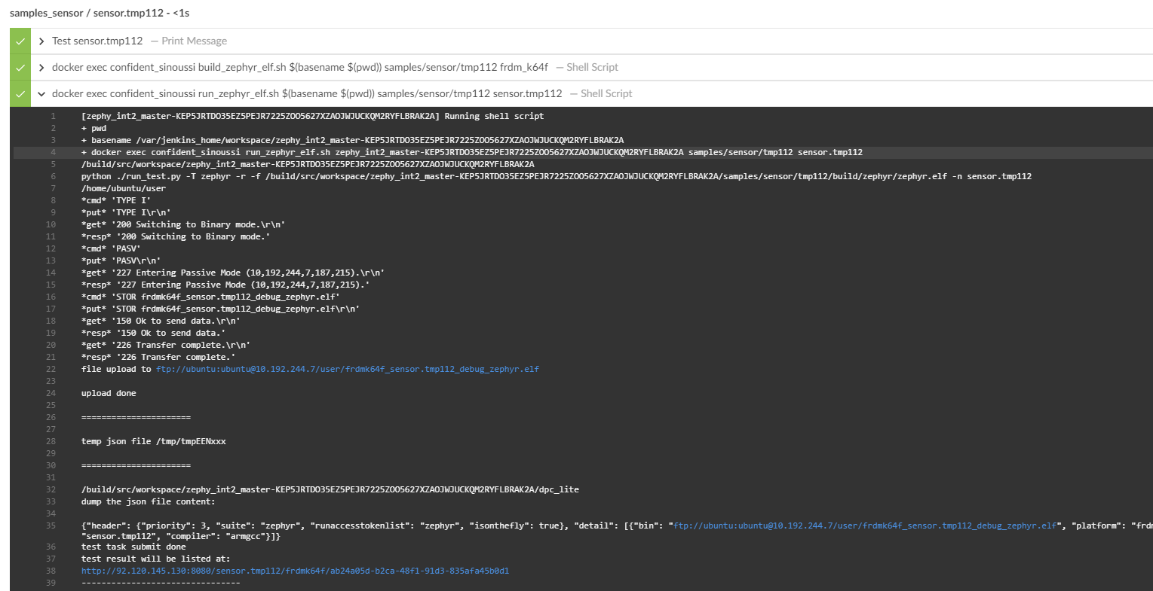
Examples
- logs

Slide 17

Benefits
Support PR integration/regression testing on real board by request
Test scope is customized by original developer
Stateless process to developer, async-process. All tasks are automatically queued on one command
Limit extra knowledge sets required, more focus on project itself.
Docker usage
Git
simple Yaml schematic
Almost zero maintenance resources required
Easy to port / expand setting can be done in 5 minutes
Work Smarter

Slide 18
Future work
Zephyr project already support gcov data output to console. We can add this feature to testing log parser, and then we can get real coverage data based on defined board and test application. https://github.com/zephyrproject-rtos/zephyr/pull/9717
Integrate with test management system.
https://zephyrproject.testrail.io/
https://github.com/zephyrproject-rtos/qm

Slide 19
Thanks

